Slide 1
25 YEARS OF WATER QUALITY CHANGE IN RHODE ISLAND LAKES AND PONDS
B. J. Kreakie¹, J. W. Hollister¹, D.Q. Kellogg², S.D. Shivers³, E.M. Herron⁴, L.T. Green⁴, A.J. Gold²
1 US EPA Office of Research and Development
2 University of Rhode Island Dept. of Natural Resources Science
3 ORISE Fellow, EPA Office of Research and Development, AED
4 University of Rhode Island Watershed Watch
of Natural Resources Science
Rhode Island Watershed Watch

Slide 2
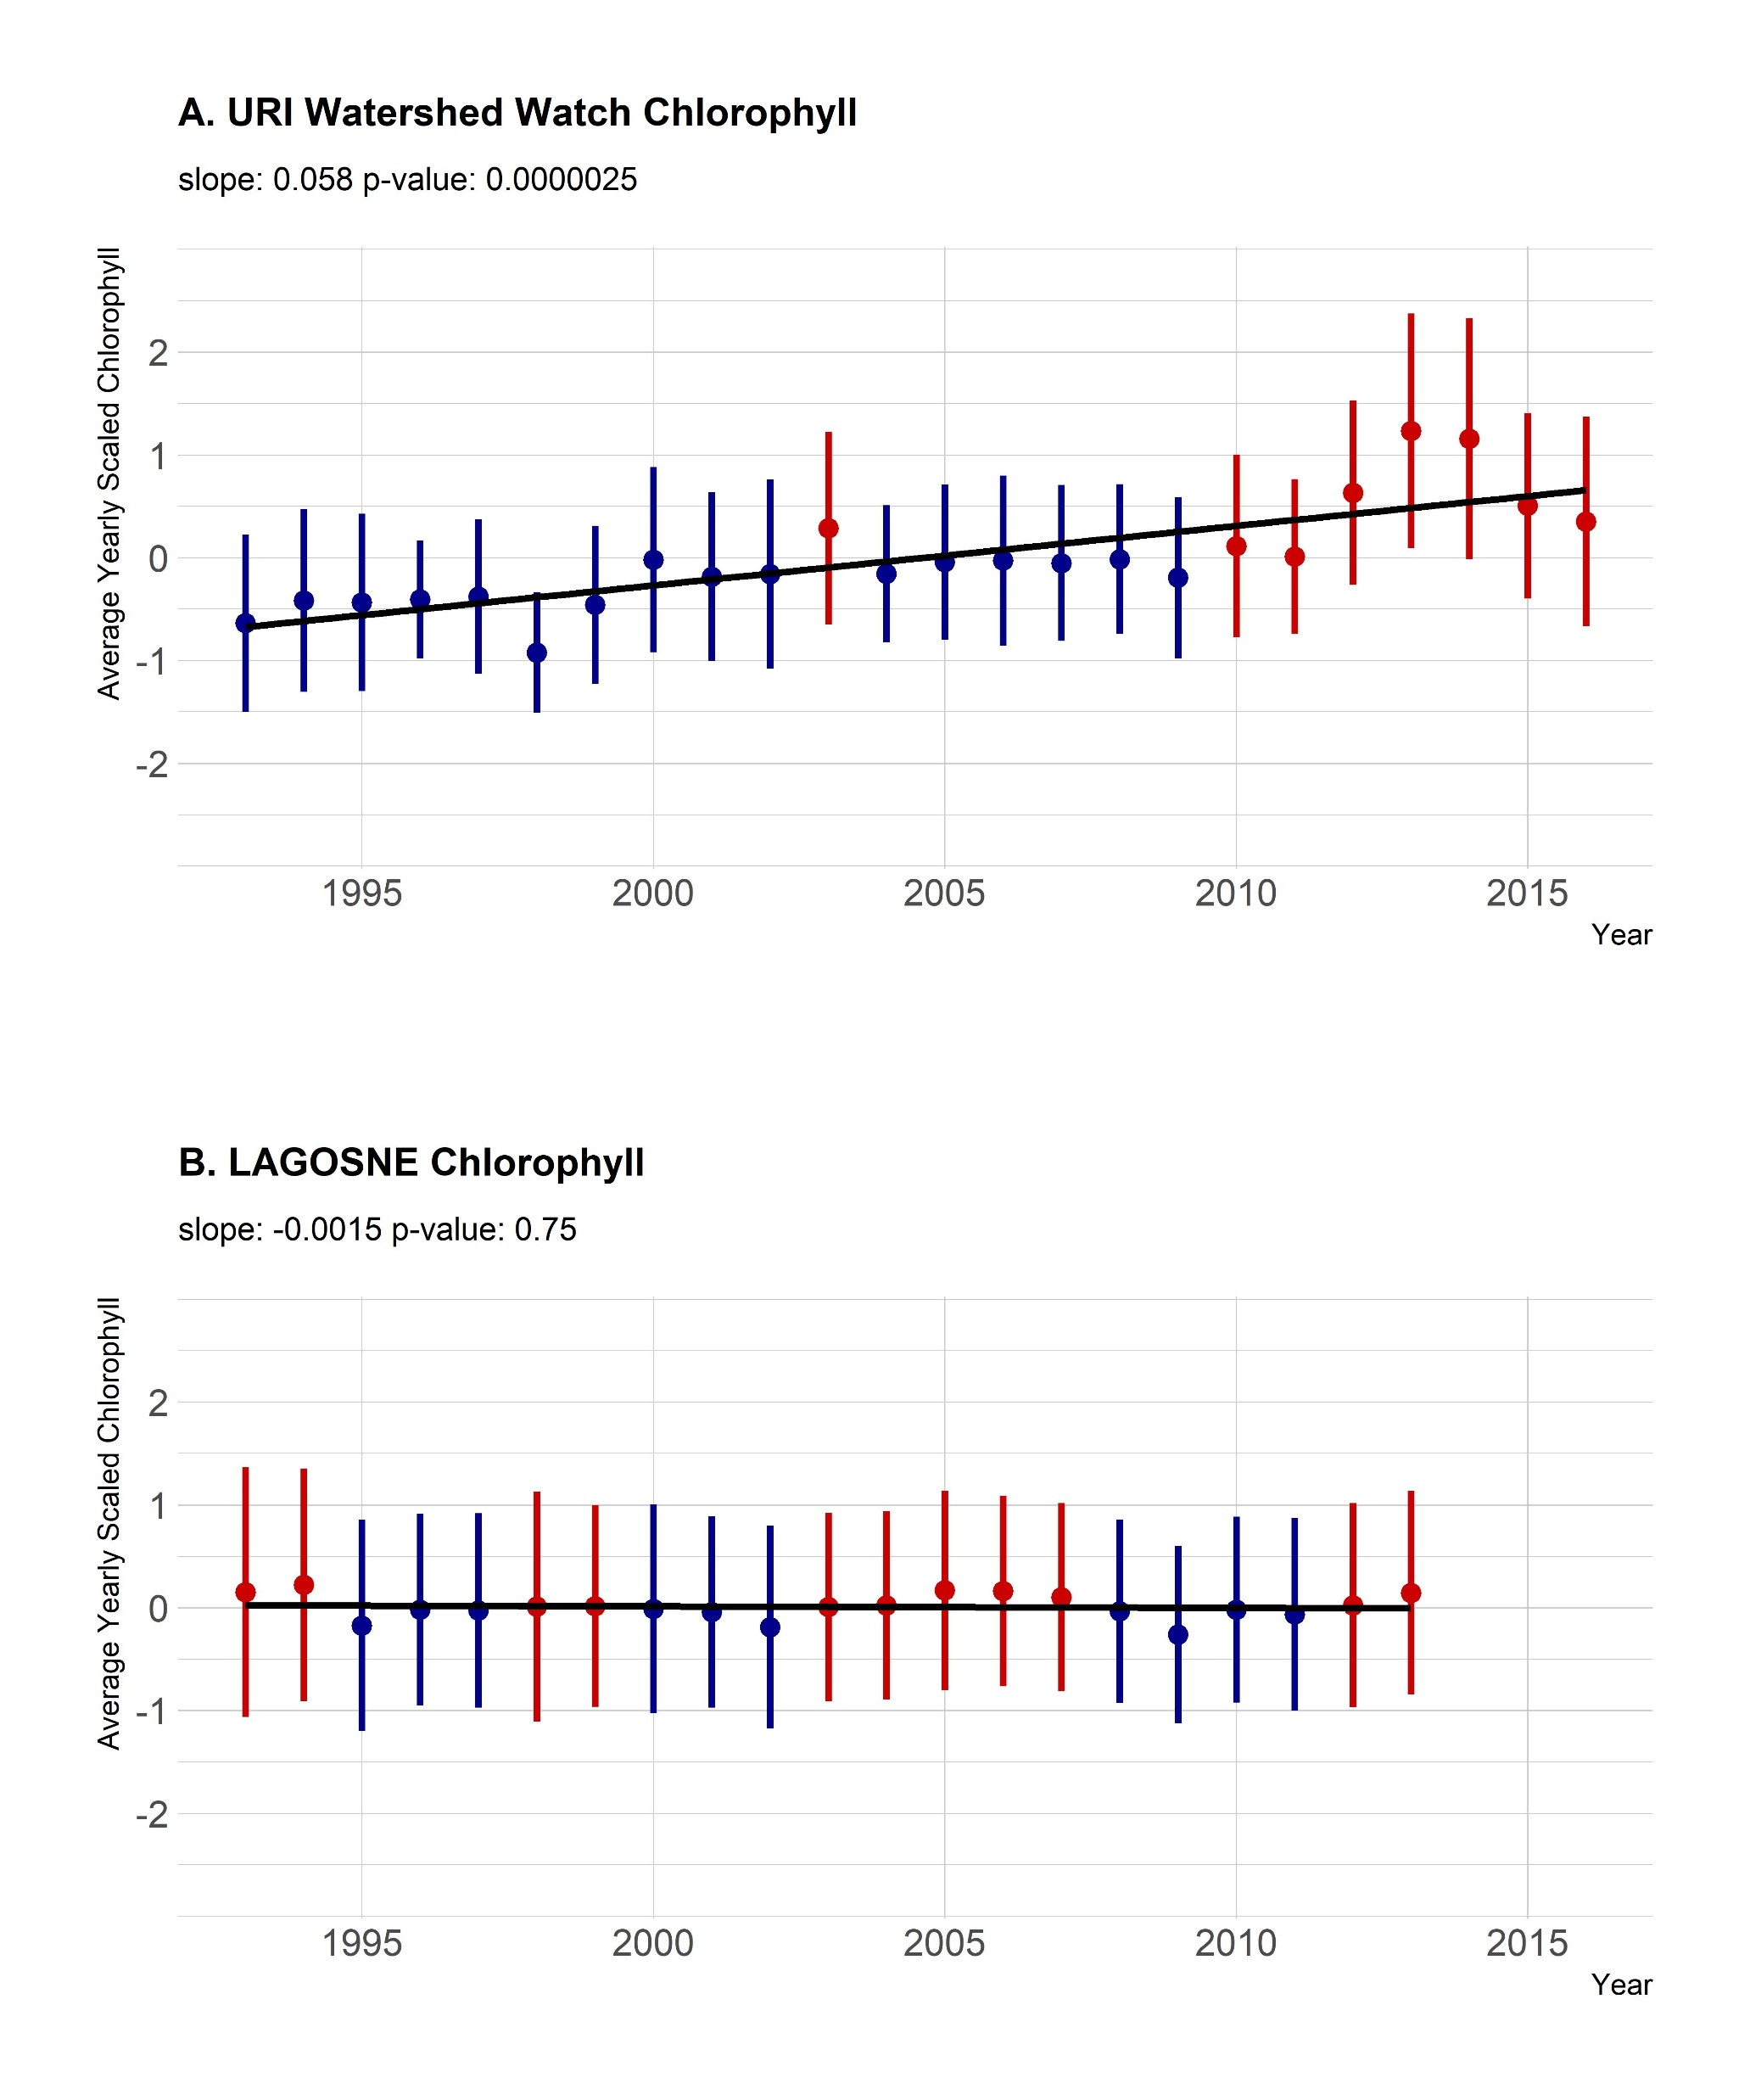

Slide 3
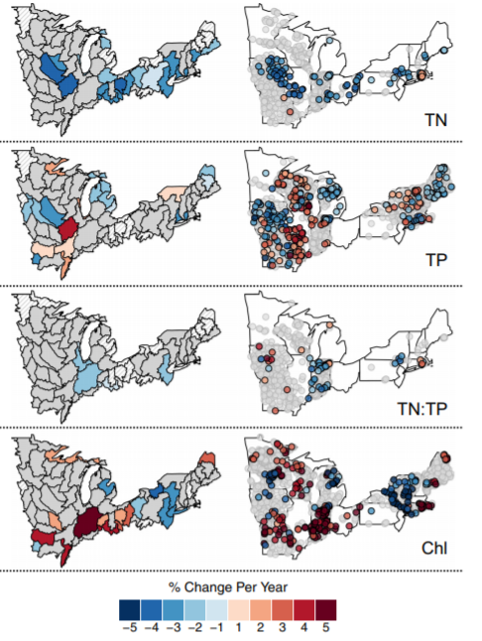
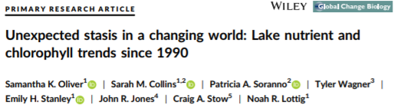
Trends in decadal water quality changes… stasis?
Oliver et. al. 2017. Global Change Biology 23:5455-5467
Notes:
The data that I’ll be talking about today is from freshwater lakes and ponds. The sampling season generally runs from April to November and the protocol includes weekly sampling of water clarity, reported as secchi depth, and water temperature; bi-weekly sampling of chorophyll-a and dissolved oxygen, and then three times per season samples are collected for lab analysis of nutrients, alkalinity, pH and bacteria. For deeper lakes, there may be samples taken near the surface and near the bottom. A “deep” lake in RI is greater than 6 m deep, and we don’t have many of those. CHECK THIS

Slide 4
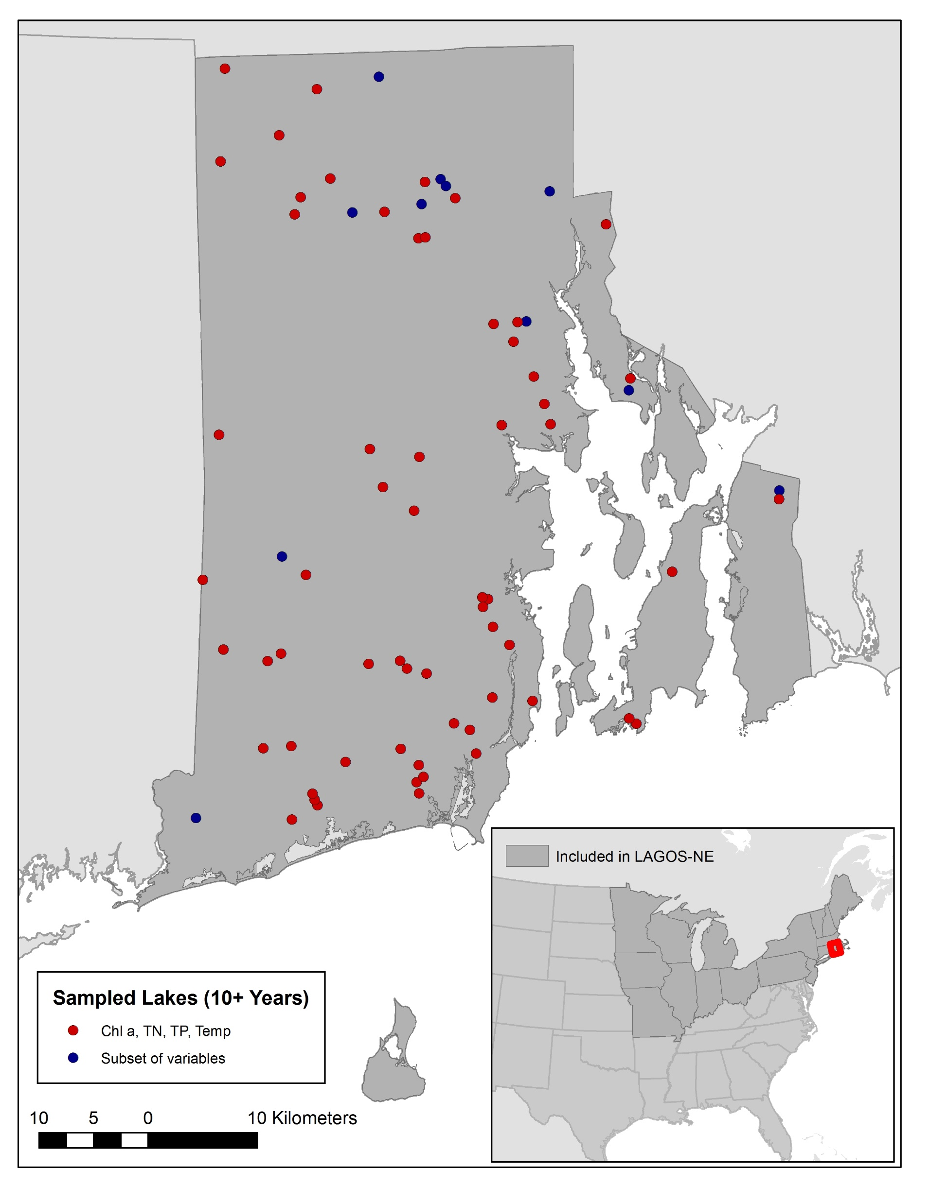
METHODS
R package: https://cran.rproject.org/web/packages/LAGOSNE/index.html LAGOS website:
https://lagoslakes.org
Notes:
So for the long-term analysis of lake water quality we used data from lakes, ponds and reservoirs, looking at all data collected over the years 1990 to 2016.
We bracketed the season at May through October and looked at how 4 water quality parameters may have changed: Temperature, Chl-a, TN, and TP. We only used data collected at these sites at approximately 1 m depth.
We filtered the data so that we were left with only those sites that had at least 10 years of observations for at least one of these parameters over that time period of 1990 to 2016, leaving us with 72 sites. 85% of those sites have at least 10 years of data for all four parameters.
The map shows those lakes in red, while the other 15% where they 10+ years for a subset of those parameters are shown in blue.
We did an anomaly analysis on these data, which I’ll explain in a moment, but it’s a common method for identifying long-term trends in noisy data like precipitation or air temperature.
As a point of comparison, we did the same analysis on the full LAGOS-NE dataset which includes data from the northeast quadrant of the US, shown in the map inset as dark grey, with RI being the small red area on the east coast. Our RI data are also in the LAGOS-NE dataset.

Slide 5
URI Watershed Watch overview
URI Cooperative Extension Water Quality Group
web.uri.edu/watershedwatch/
Volunteer monitoring (~400 volunteers)
Rigorous QA/QC, EPA-certified lab
Data are used by RI DEM and EPA to assess water quality
Over 30 years
Begun in 1988 with 14 lakes
Now monitors +250 sites on +120 water bodies
Notes:
The data have been collected over the years by a large group of volunteers led by a program called Watershed Watch based at the University of Rhode Island’s Cooperative Extension Water Quality Group. Some have been with the program for most of its existence, others have come and gone, but all have been well-trained by Linda Green and Elizabeth Herron who run the program and ensure that proper protocols are followed. They also oversee the QA/QC of the data as it moves from paper postcards, sometimes online data entry, into spreadsheets and then out to the public. The data are used by RI DEM and the EPA for the state’s bi-annual integrated report on water quality. WW started in 1988 with 14 lakes, and it’s now grown to monitoring more than 250 sites on over 120 water bodies, now including not only lakes and ponds but also stream reaches, coastal salt ponds and embayments.

Slide 6
URI WW Lakes
Weekly: Water clarity (Secchi depth), Temperature
2X per Month: Chl-a, DO
3X per Season: Nutrients, Alkalinity, pH, Bacteria
Notes:
The data that I’ll be talking about today is from freshwater lakes and ponds. The sampling season generally runs from April to November and the protocol includes weekly sampling of water clarity, reported as secchi depth, and water temperature; bi-weekly sampling of chorophyll-a and dissolved oxygen, and then three times per season samples are collected for lab analysis of nutrients, alkalinity, pH and bacteria. For deeper lakes, there may be samples taken near the surface and near the bottom. A “deep” lake in RI is greater than 6 m deep, and we don’t have many of those. CHECK THIS

Slide 7
METHODS
Lakes, ponds, reservoirs
1990 to 2016
May to October
Temperature, Chl-a, TN, TP
~ 1 m depth
Minimum of 10 years of data
Notes:
So for the long-term analysis of lake water quality we used data from lakes, ponds and reservoirs, looking at all data collected over the years 1990 to 2016.
We bracketed the season at May through October and looked at how 4 water quality parameters may have changed: Temperature, Chl-a, TN, and TP. We only used data collected at these sites at approximately 1 m depth.
We filtered the data so that we were left with only those sites that had at least 10 years of observations for at least one of these parameters over that time period of 1990 to 2016, leaving us with 72 sites. 85% of those sites have at least 10 years of data for all four parameters.
The map shows those lakes in red, while the other 15% where they 10+ years for a subset of those parameters are shown in blue.
We did an anomaly analysis on these data, which I’ll explain in a moment, but it’s a common method for identifying long-term trends in noisy data like precipitation or air temperature.
As a point of comparison, we did the same analysis on the full LAGOS-NE dataset which includes data from the northeast quadrant of the US, shown in the map inset as dark grey, with RI being the small red area on the east coast. Our RI data are also in the LAGOS-NE dataset.

Slide 8
METHODS
Lakes, ponds, reservoirs
1990 to 2016
May to October
Temperature, Chl-a, TN, TP
~ 1 m depth
Minimum of 10 years of data
72 sites
85% of sites have at least 10 years
of all 4 parameters
Notes:
So for the long-term analysis of lake water quality we used data from lakes, ponds and reservoirs, looking at all data collected over the years 1990 to 2016.
We bracketed the season at May through October and looked at how 4 water quality parameters may have changed: Temperature, Chl-a, TN, and TP. We only used data collected at these sites at approximately 1 m depth.
We filtered the data so that we were left with only those sites that had at least 10 years of observations for at least one of these parameters over that time period of 1990 to 2016, leaving us with 72 sites. 85% of those sites have at least 10 years of data for all four parameters.
The map shows those lakes in red, while the other 15% where they 10+ years for a subset of those parameters are shown in blue.
We did an anomaly analysis on these data, which I’ll explain in a moment, but it’s a common method for identifying long-term trends in noisy data like precipitation or air temperature.
As a point of comparison, we did the same analysis on the full LAGOS-NE dataset which includes data from the northeast quadrant of the US, shown in the map inset as dark grey, with RI being the small red area on the east coast. Our RI data are also in the LAGOS-NE dataset.

Slide 9
Year 1
Year 2
Year 3
Station 1
Long-term mean = 7.06
Long-term
s.d. = 1.42
data
5
4
8
Site and Year mean
5.67
data
6
9
6
Site and Year mean
7
data
8
9
Site and Year mean
8.5
Site and Year Z-score
Site and Year Z-score
Site and Year Z-score
(5.67 – 7.06) 1.42
= -0.98
(7 – 7.06) 1.42
= -0.04
(8.5 – 7.06) 1.42
= 1.02
Station 2
Long-term mean = 3.67
Long-term
s.d. = 0.92
data
2
3
3
4
Site and Year mean
3
data
4
3
6
Site and Year mean
4.33
Site and Year Z-score
Site and Year Z-score
(3 – 3.65) 0.92
= -0.71
(4.3 – 3.65) 0.92
= 0.71
Station 3
Long-term mean = 12.44
Long-term
s.d. = 1.90
data
11
15
Site and Year mean
13
data
14
Site and Year mean
14
data
10
12
9
Site and Year mean
10.3
Site and Year Z-score
Site and Year Z-score
Site and Year Z-score
(13 – 12.43) 1.91
= 0.29
(14 – 12.43) 1.91
= 0.82
(10.3 – 12.42) 1.91
= -1.11
Mean
Z-scores
mean z-scores = -0.47
s.d. z-scores = 0.67
n = 3
mean z-scores = 0.39
s.d. z-scores = 0.61
n = 2
mean z-scores = 0.20
s.d. = 1.15
n = 3

Slide 10
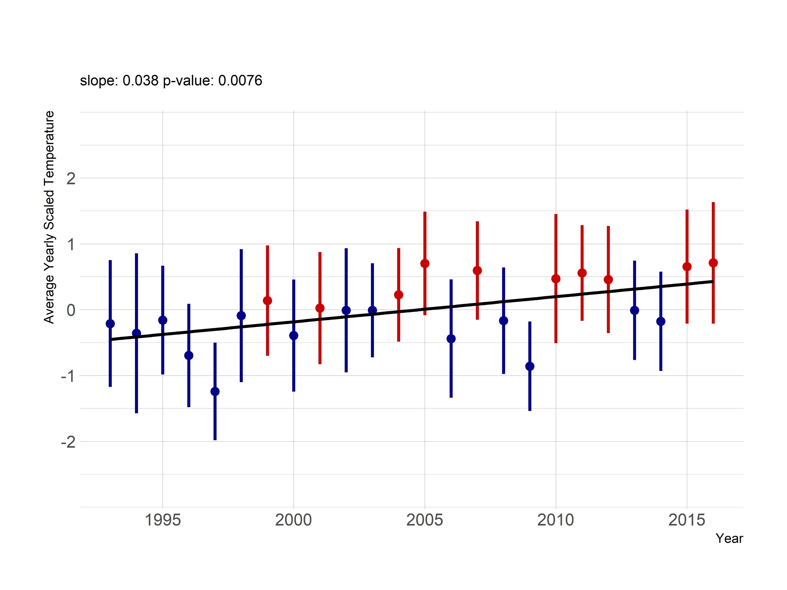
Water Temperature
Notes:
Here is the anomaly analysis of the water temperature. Anomaly analysis looks at how different each year is from the long term mean. we’re looking at each lake individually, then taking the mean of each lakes’ anomaly with respect to itself. First we Look at each water body individually; find the seasonal mean (May to October); scaled deviation from the long-term mean (25 years). Average scaled deviation across all water bodies for each year. Red = positive, Blue = negative Each measurement was centered by mean and scaled by sd (per site) (mean and sd calculated per site); Average z-score per year.

Slide 11
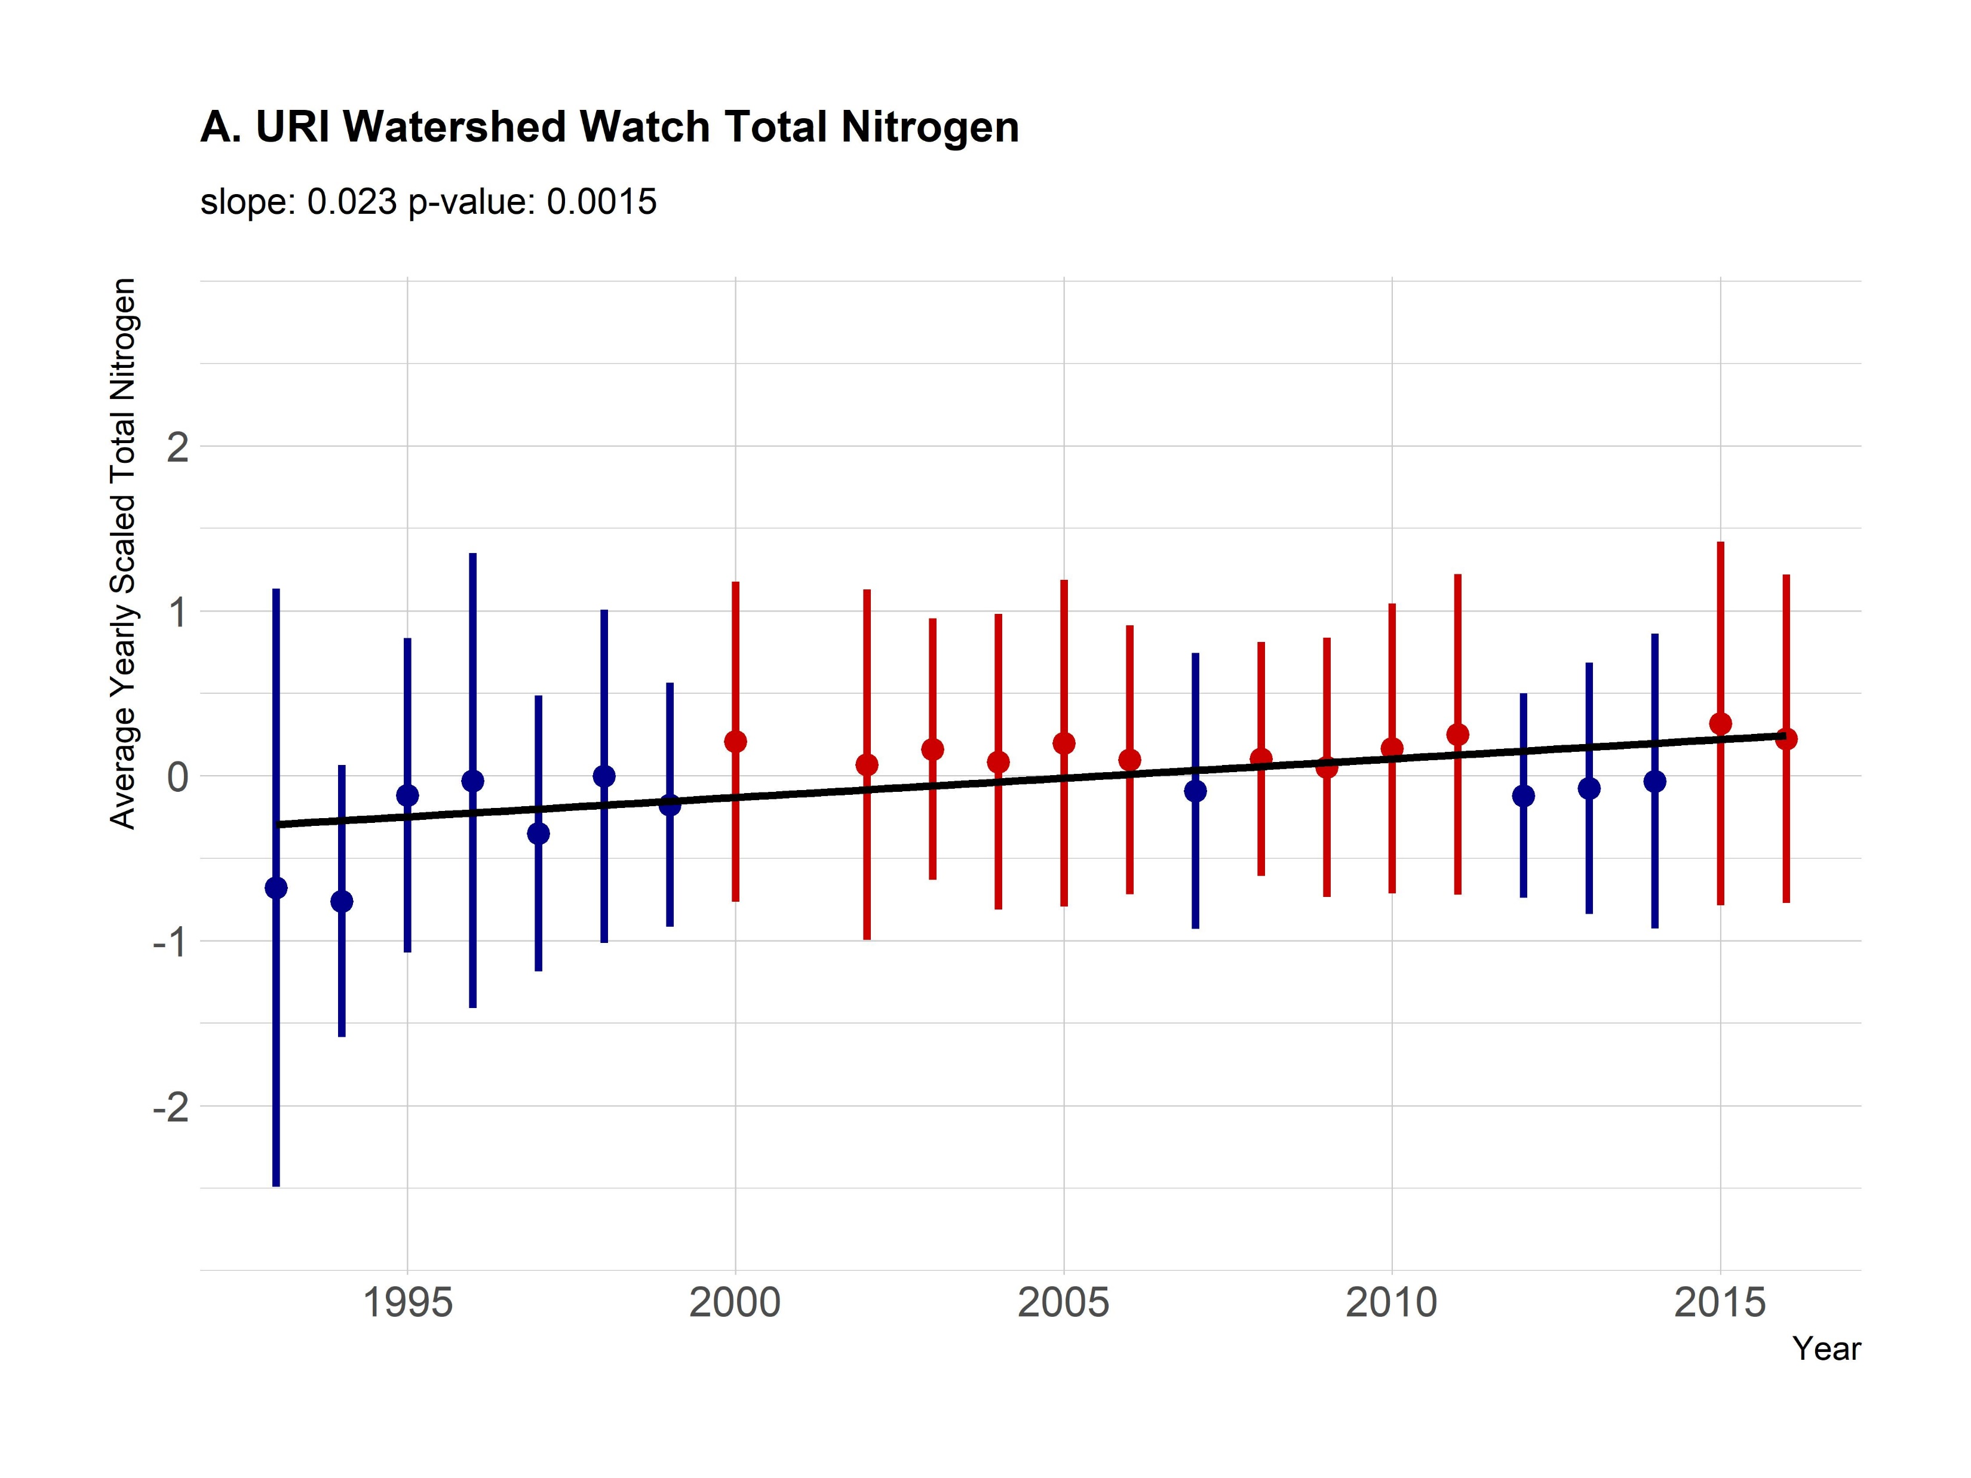
Total Nitrogen
Notes:
Missing several years of nutrient data

Slide 12
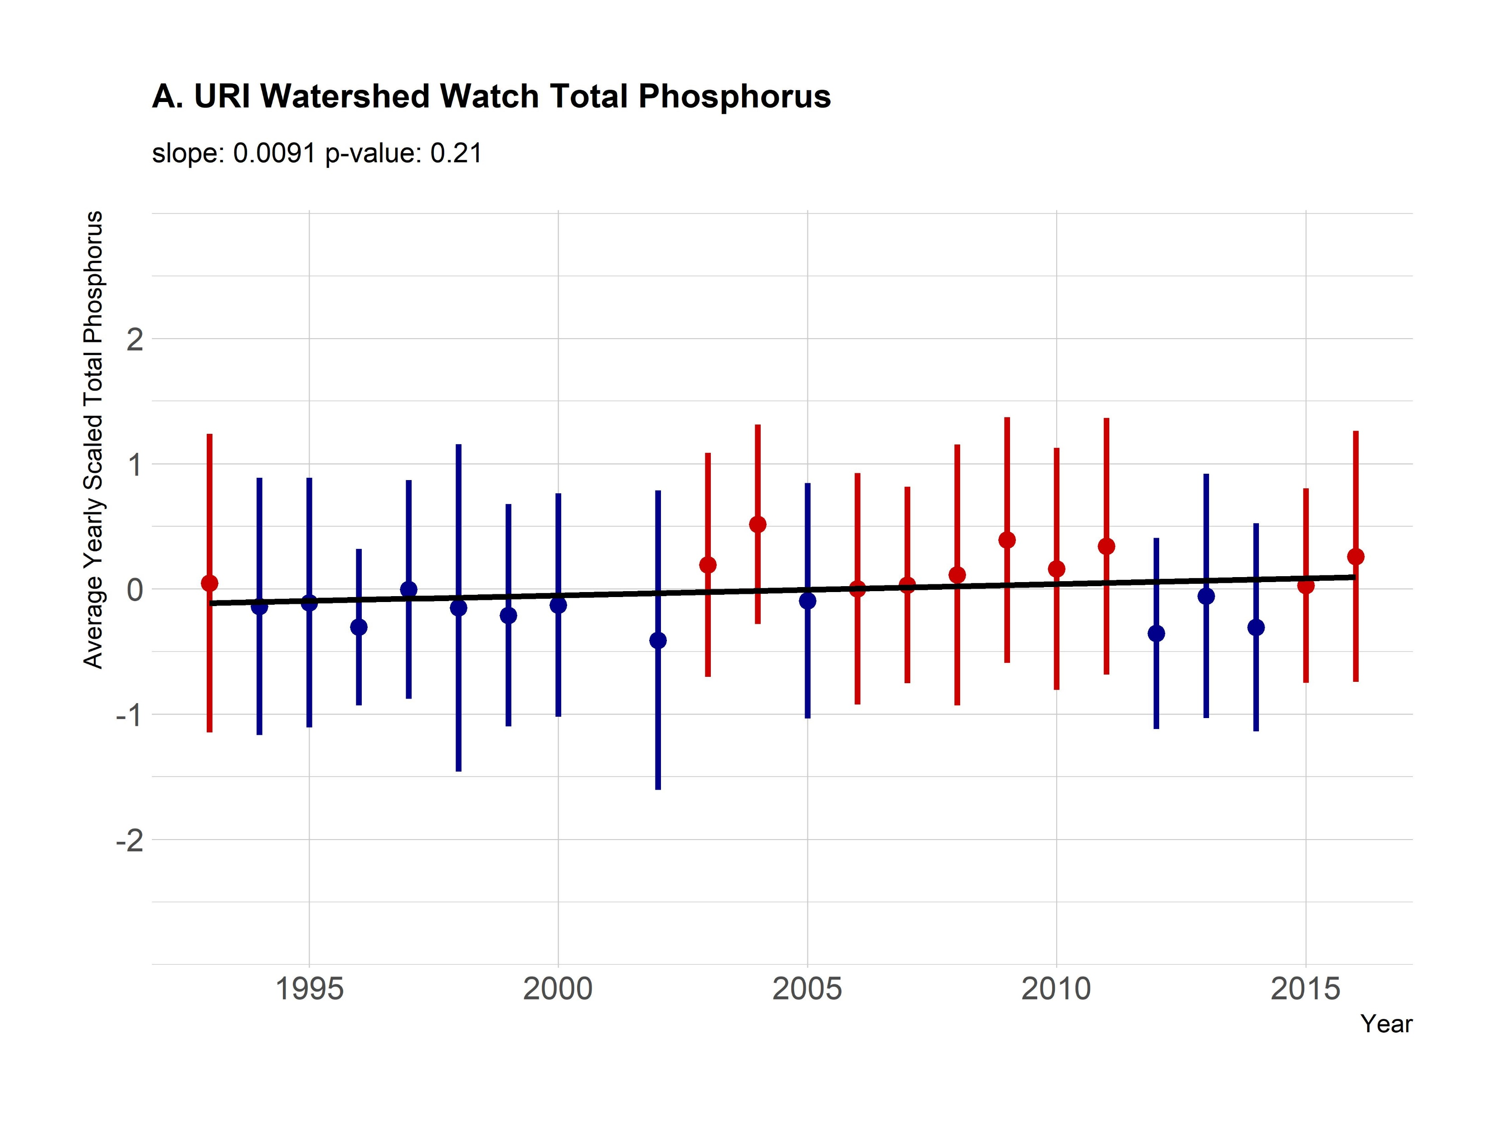
Total Phosphorus

Slide 13
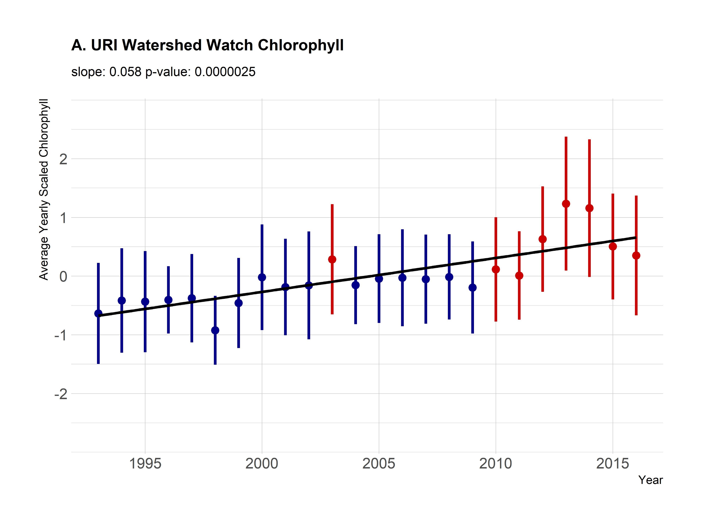
Chlorophyll a

Slide 14
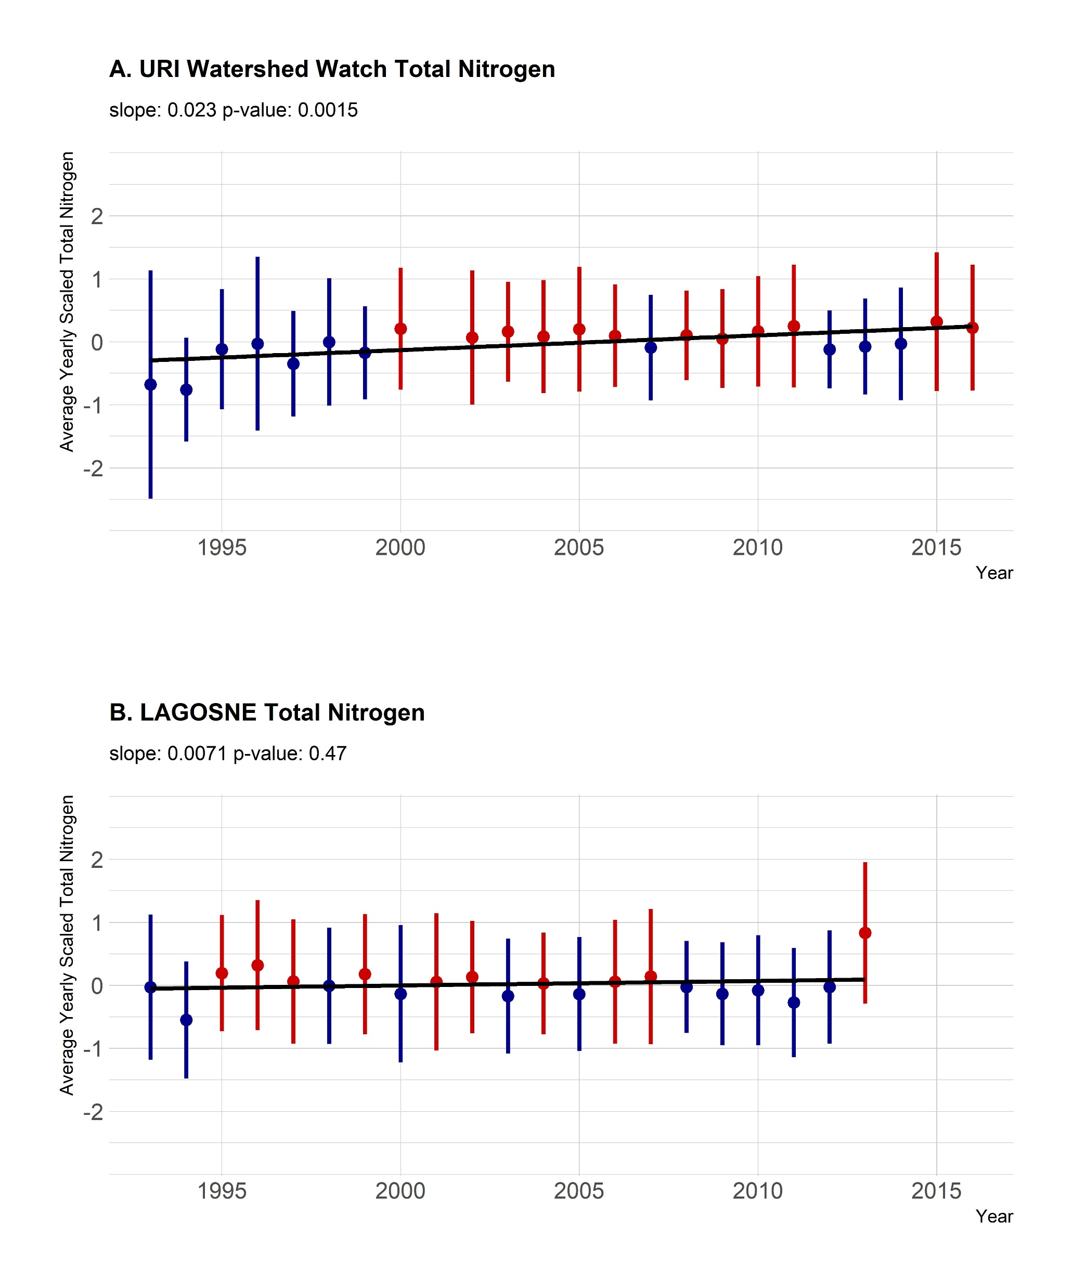
Notes:
THERE’s NO TEMP DATA in the LAGOS data set, so we couldn’t compare temp
– same parameter, same time period, same water depth (??), # lakes??, larger geographic region so wider range of types of lakes (elevation, size, land use)

Slide 15
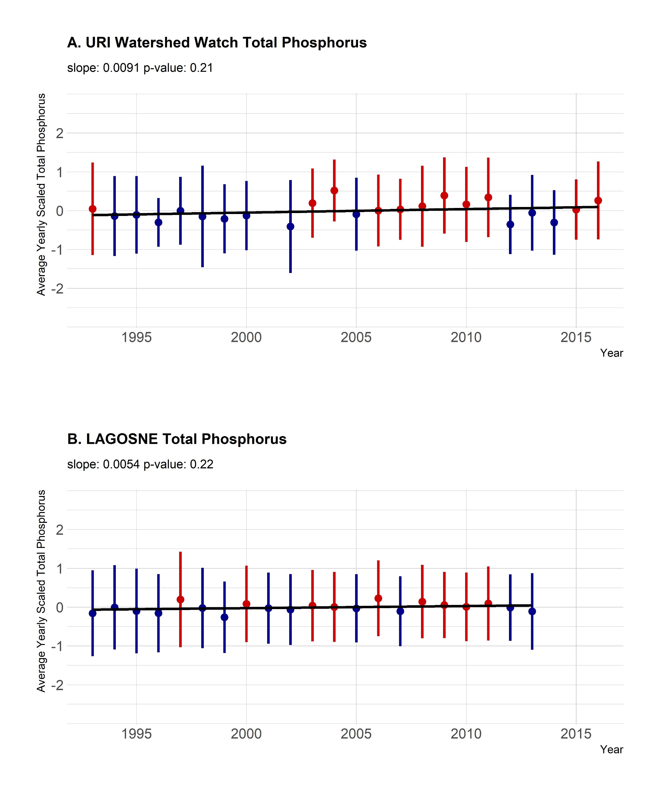

Slide 17
Trends in Rhode Island’s lakes:
Temperature increasing
TN increasing
TP stable
Chl-a increasing
Notes:
Large-scale drivers – large-scale land use change, atmospheric deposition

Slide 18
Trends in Rhode Island’s lakes:
Temperature increasing
TN increasing
TP stable
Chl-a increasing
Compared to larger region (LAGOS-NE):
Our analysis shows similar results to Oliver et al. (2017)
Smaller region (RI) shows different results to larger region (LAGOS-NE)
Oliver, S.K., S.M. Collins, P.A. Soranno, T. Wagner, E.H. Stanley, J. Jones, C. Stow, N. Lottig. 2017. Unexpected stasis in a changing world: Lake nutrient and chlorophyll trends since 1990. Global Change Biology 23:5455–5467 doi: 10.1111/gcb.13810
Notes:
Large-scale drivers – large-scale land use change, atmospheric deposition

Slide 19
Trends in Rhode Island’s lakes:
Temperature increasing
TN increasing
TP stable
Chl-a increasing
Compared to larger region (LAGOS-NE):
Our analysis shows similar results to Oliver et al. (2017)
Smaller region (RI) shows different results to larger region (LAGOS-NE)
…SCALE MATTERS
High variability within large regions - difficult to detect trends
Local management critical
Oliver, S.K., S.M. Collins, P.A. Soranno, T. Wagner, E.H. Stanley, J. Jones, C. Stow, N. Lottig. 2017. Unexpected stasis in a changing world: Lake nutrient and chlorophyll trends since 1990. Global Change Biology 23:5455–5467 doi: 10.1111/gcb.13810
Notes:
Large-scale drivers – large-scale land use change, atmospheric deposition

Slide 20
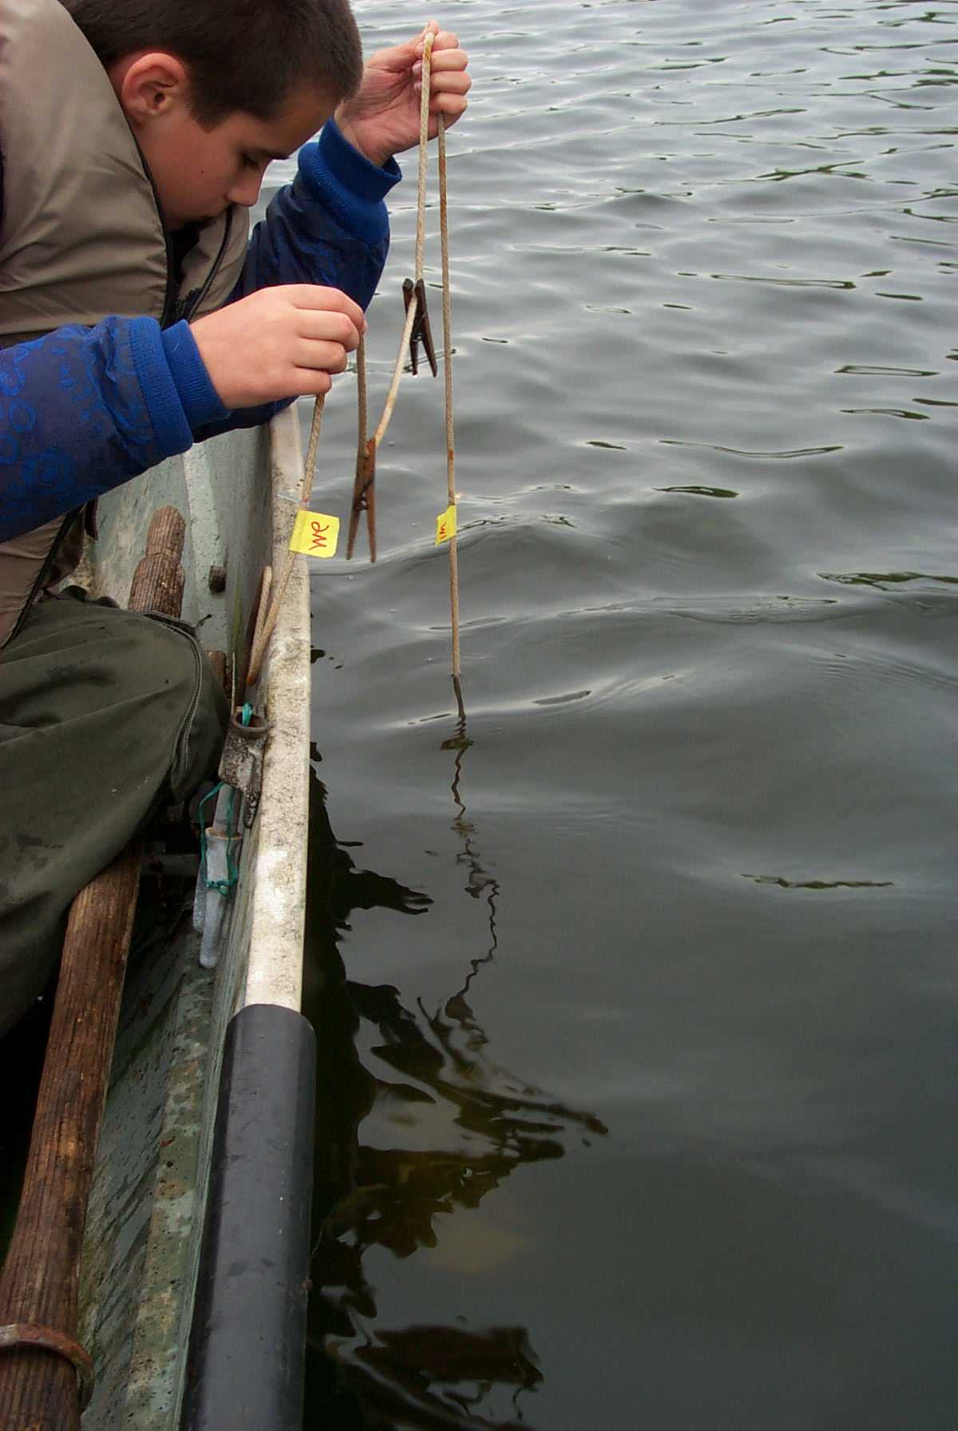
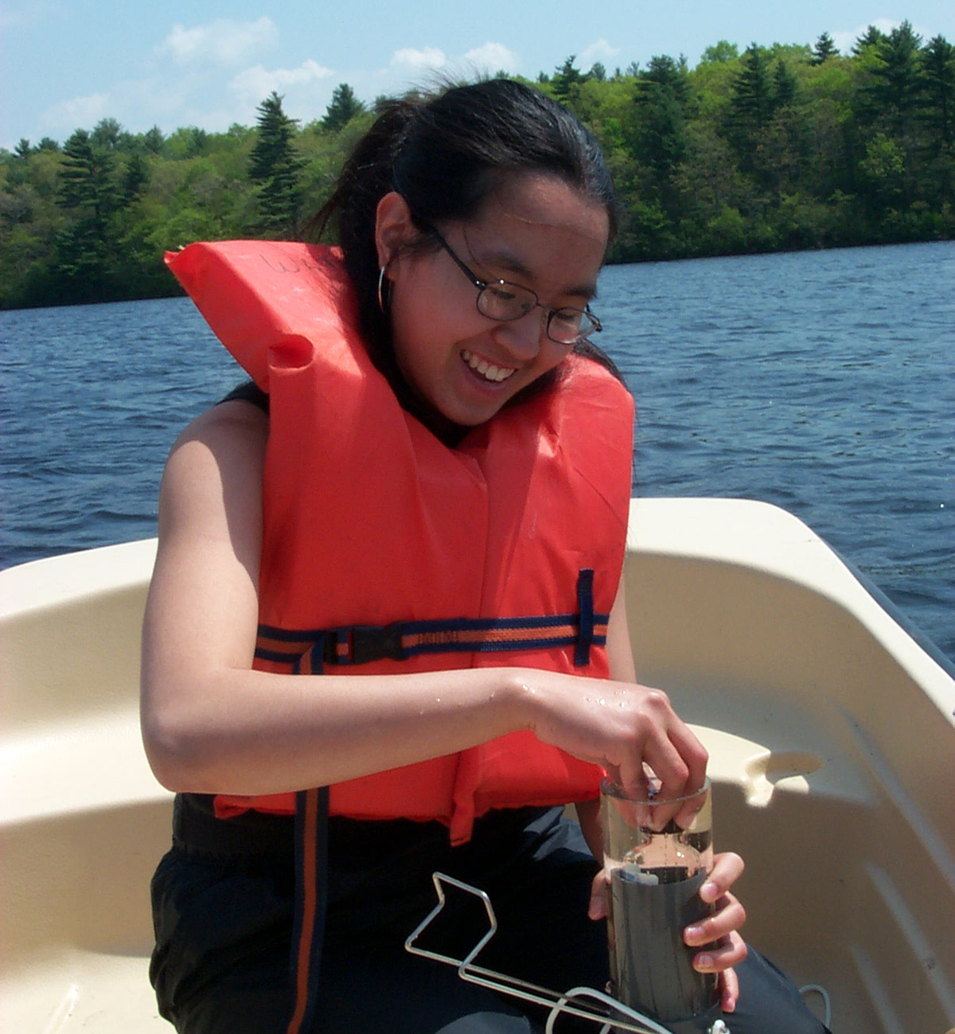
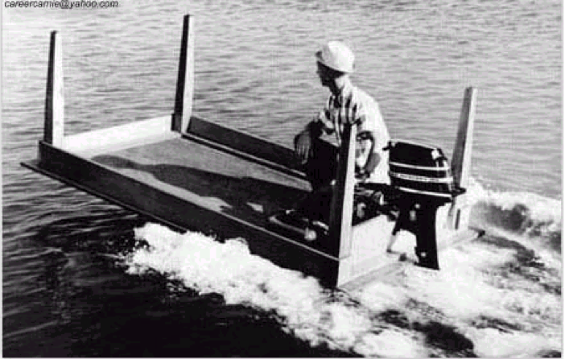
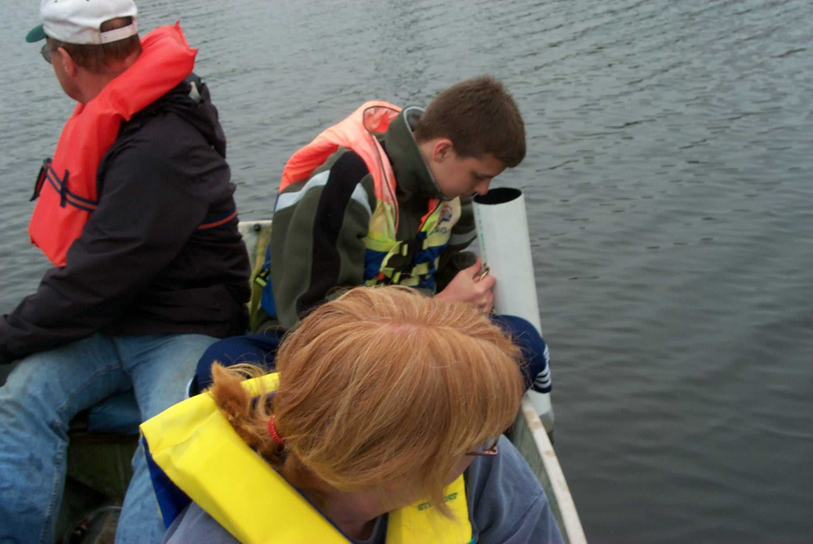
Thank you to the hundreds of volunteers
Thank you!
Questions?
More at:
https://github.com/USEPA/ri_wq_trends

